Slide 1

Green Pace
Security Policy Presentation
Developer: Tonya Sanders
CS 405
Dr. Mimi Tam
Southern New Hampshire University

Slide 2

OVERVIEW: DEFENSE IN DEPTH
This security policy adopts a defense-in-depth strategy, which involves implementing multiple layers of security mechanisms to create a robust protective framework against potential risks and vulnerabilities. By ensuring that if one security measure fails, additional safeguards remain in place, we can enhance our overall security posture. Each layer, including firewalls, intrusion detection systems, encryption, and access controls, serves a specific role in safeguarding our sensitive data and mitigating risks. This proactive approach aims to identify and address vulnerabilities before they can be exploited, reinforcing our commitment to maintaining a secure environment.

Slide 3
THREATS MATRIX
Probability | Severity | Severity
 | Low | Medium | High
Likely | STD-003-CPP STD-008-CPP | STD-004-CPP STD-005-CPP STD-010-CPP | STD-002-CPP STD-009-CPP
Probable |  | STD-007-CPP | STD-007-CPP
Unlikely |  | STD-006-CPP | STD-001-CPP

Slide 4
10 PRINCIPLES
Validate Input Data: STD-002-CPP, STD-009-CPP
Heed Compiler Warnings: STD-007-CPP
Architect and Design for Security Policies
Keep It Simple: STD-004-CPP, STD-005-CPP, STD-008-CPP
Default Deny: STD-001-CPP
Adhere to the Principle of Least Privilege
Sanitize Data Sent to Other Systems
Practice Defense in Depth
Use Effective Quality Assurance Techniques: STD-006-CPP
Adopt a Secure Coding Standard: STD-003-CPP, STD-010-CPP

Slide 5
CODING STANDARDS
Rule | Severity | Likelihood | Remediation Cost | Priority | Level
STD-001-CPP | Low | Unlikely | High | P1 | L3
STD-002-CPP | High | Likely | High | P9 | L2
STD-003-CPP | Low | Likely | Low | P9 | L2
STD-004-CPP | High | Likely | Medium | P18 | L1
STD-005-CPP | High | Likely | Medium | P18 | L1
STD-006-CPP | Medium | Unlikely | Medium | P4 | L3
STD-007-CPP | Low | Probable | Medium | P4 | L3
STD-008-CPP | Low | Likely | Medium | P6 | L2
STD-009-CPP | High | Likely | High | P9 | L2
STD-010-CPP | Low | Unlikely | High | P1 | L3

Slide 6
ENCRYPTION POLICIES
Encryption at Rest
Ensures all sensitive data stored on physical devices or cloud storage is protected by encryption.
Prevents unauthorized access, even with physical access to the storage.
Applies to various storage mediums, including Hard drives, Mobile devices, Computers, Cloud assets
Utilizes encryption tools like disk encryption and mobile security protocols.
Requires encryption keys for data access, protecting against internal and external threats.
Encryption in Flight
Ensures data is encrypted during transmission between devices, both within a network and externally.
Protects against interception of data in transit, especially over insecure connections (e.g., unprotected Wi-Fi).
Prevents attackers from accessing sensitive information mid-transfer.
Employs methods such as Email encryption, Data Loss Prevention (DLP) solutions, Firewalls, Strong authentication measures
Ensures that only authorized recipients can access the transmitted data.
Encryption in Use
Ensures sensitive data remains encrypted while being accessed, created, or modified.
Protects data from exposure during vulnerable moments, such as processing in memory.
Applies encryption at all stages for continuous protection through defense-in-depth.
Layers multiple defenses around the data to minimize potential attack points.
Manages access rights and identity to limit exposure, ensuring only authorized users can interact with the data.

Slide 7
TRIPLE-A POLICIES
Authentication
Verifies a user's identity before granting access to sensitive systems.
Utilizes methods such as Static passwords, One-time password, Certifications,Biometric credentials
Acts as the first layer of defense, allowing systems to accept or reject access.
Ensures that only authorized individuals can interact with sensitive information.
Authorization
Defines the rights and privileges of authenticated users.
Determines access levels within a system.
Limits access to only the resources necessary for users' roles.
Applies the principle of least privilege to minimize security risks and prevent unauthorized activities.
Accounting
Tracks and records user activities, including Timestamps, Accessed resources, Data transfers
Creates an audit trail for compliance and security purposes.
Identifies risky behavior early for timely threat responses.
Holds users accountable and provides evidence for forensic analysis in case of security breaches.

Slide 8
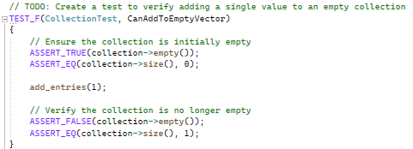
Unit Test: CanAddToEmptyVector
Test to verify adding a single value to an empty collection

Slide 9
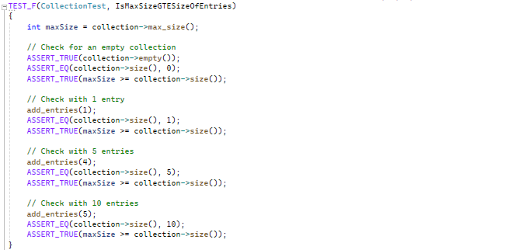
Unit Test: IsMaxSizeGTESizeOfEntries
Test to verify max size is greater than or equal to size for 0, 1, 5, 10 entries

Slide 10
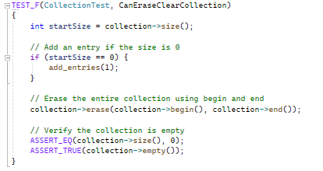
Unit Test: CanEraseClearCollection
Test to verify erase(begin,end) erases the entire collection

Slide 11
AUTOMATION SUMMARY
Green Pace’s established DevOps process lays the groundwork for integrating automated security measures through a DevSecOps approach, enhancing the security and efficiency of the entire pipeline. Key stages for automation include:
Pre-Production:
Assess and Plan: Introduce threat modeling.
Design and Build: Prioritize IDE security.
Verify & Test: Incorporate automated unit testing, static application testing, and security scans to ensure code quality and compliance.
Production:
Implement penetration testing and integrity checks.
Use defense-in-depth measures.
Employ monitoring tools to automatically alert teams to risky events or performance issues, enabling rapid threat response.

Slide 12

AUTOMATION SUMMARY

Slide 13
TOOLS
Tools For Automation:
Parasoft C/C++test – Used during the design, verify/test stage in pre-production. Used during the transition/health check and maintain and stabilize stage in post-production.
LoadNinja – Used in the verify and test pre-production for stress testing. Used during the maintain and stabilize in post-production,
Logentries – Used during the monitor and detect stage in post-production, to automate information logging.
Intruder – Used during transition and health check stage of post-production to perform penetration tests.

Slide 14
RISKS AND BENEFITS
Implementing security protocols and automation early on is crucial for protecting sensitive data and ensuring the long-term security of a system. Delaying these implementations can expose the system to potential breaches, leading to a loss of trust, financial liability, and reputational damage. Although there may be upfront costs and time investment involved, these are outweighed by the potential benefits, including a more secure infrastructure, cost savings from avoiding security breaches, and a higher quality final product.
Risks of Acting Now:
Upfront cost in terms of resources and tools
Requires time to implement, potentially slowing other tasks
Need for specialized expertise and training
Increases complexity in system management
Benefits of Acting Now:
Prevents costly security breaches in the future
Saves money from potential loss of data or trust
Early implementation is simpler and more effective
Strengthens defense against potential attackers and threats

Slide 15
RECOMMENDATIONS
Regular Policy Reviews
Security policies should undergo frequent reviews and updates to ensure they adapt to new threats and identified gaps.
External Security Testing
Annual external audits, such as from white hat security firms, are essential for real-world testing and vulnerability assessments.
Implementation of Security Policies
Security measures should be applied early in the development process to ensure security is integrated into every stage, reducing risks post-production.
Unclear Enforcement in Pre-production and Response Phases
The DevSecOps build process lacks a clear strategy for selecting secure tools, and enforcement mechanisms beyond automation need definition to ensure policies are followed effectively.

Slide 16
CONCLUSIONS
Adopting a security-first mindset throughout development is essential to successfully integrate security into every aspect of Green Pace’s DevOps pipeline. This transformation involves consistently applying best practices and coding standards, while maintaining a "no one is safe" attitude towards security. By focusing on defense in depth, anticipating potential attack motives, and proactively preventing vulnerabilities, Green Pace can enhance its security posture.
Key practices include:
Adopt Best Practices and Coding Standards: Use appropriate integer precisions, avoid confusing narrow and wide character strings, and always handle exceptions properly to maintain code quality and security.
Validate and Sanitize Input Data: All data entering the system should be thoroughly validated and sanitized to prevent injection attacks and other common vulnerabilities.
Implement a Default Deny Approach: Ensure that only explicitly allowed actions and data are permitted, blocking all other inputs by default.
Follow and Regularly Review Defense in Depth Strategies: Build layered defenses throughout development and constantly revisit and refine these strategies to align with the latest security policies and threats.

Slide 17
REFERENCES
Foster, S. (n.d.). DevSecOps pipeline overview: DevSecOps simplified. Perforce Software. https://www.perforce.com/blog/kw/devsecops-pipeline-overview#:~:text=Free%20Klocwork%20Trial-,What%20Is%20a%20DevSecOps%20Pipeline%3F,secure%20software%20faster%20and%20easier.
Argintaru, D. (2021). Data encryption: How to protect data in transit, data in use, and data at rest. Mimecast.com. https://www.mimecast.com/blog/data-in-transit-vs-motion-vs-rest
Fogg, E. (2021, May 11). What can and should be automated in software development? ProdPerfect. https://prodperfect.com/blog/test-development/automated-software-development/#:~:text=Automating%20part%20of%20your%20application’s,quality%20of%20your%20test%20suite
Hill, M. (2021, July 16). The 15 biggest data breaches of the 21st century. CSO Online. https://www.csoonline.com/article/2130877/the-biggest-data-breaches-of-the-21st-century.html
What is DevSecOps? (2021). Redhat.com. https://www.redhat.com/en/topics/devops/what-is-devsecops

